Slide 1
Measuring Polygon Side Lengths

Slide 2
Lesson Overview (1 of 4)
Lesson Objective | Students will be able to use the coordinates of vertices to measure the lengths of any horizontal or vertical polygon side. Student-Friendly Objective: You will be able to measure the side lengths of a polygon on the coordinate plane without counting. Language Objective: Students will talk about the x- and y-coordinates of points.
Lesson Description | This lesson begins by using the coordinate plane to measure the length of several horizontal line segments. From that students are asked to look at what coordinate stays the same and what coordinate changes for each horizontal line segment. A relationship between the changing coordinate and the length of the line segment (previously found using last lesson’s method) is also discussed. Next this relationship is formalized as a second method for calculating length and it is used for the same examples previously done with the old method as a check that both methods agree. A similar process is used for vertical line segments followed by an example problem using a polygon. After the launch students practice in pairs calculating side lengths using coordinates and several problems are reviewed with the whole class.

Slide 3
Lesson Overview (2 of 4)
Lesson Vocabulary | x-coordinate: the first coordinate of a point that tells you how far left/right to go along the x-axis. y-coordinate: the second coordinate of a point that tells you how far up/down to go along the y-axis. Polygon: A shape made up of all straight sides that do not intersect. The shape is “closed” which means all the sides connect. Vertex (vertices): the point (or points) that are the corners of a polygon.
Materials | This lesson requires the following handouts: Warm-Up (there are two versions), Launch, Practice, Extension, Exit Ticket and Homework.
Common Core State Standard | 6.G.A.3. Draw polygons in the coordinate plane given coordinates for the vertices; use coordinates to find the length of a side joining points with the same first coordinate or the same second coordinate. Apply these techniques in the context of solving real-world and mathematical problems.

Slide 4
Lesson Overview (3 of 4)
Scaffolding | This lesson makes use of color to emphasize the connection between coordinates that change, stay the same, and their relationship to line segment length. Also repetition with multiple examples is used to help make connections (see slide 16-18 and 27-20). Furthermore this lesson does not only teach a new method to measure length using coordinates, but it connects the new method with the method learned in the previous lesson. The lesson is meant to build off of prior knowledge, not replace it.
Enrichment | Advanced students have challenge problems in the Practice handout that make use of length to find new points. Also advanced students have an Extension handout that may be used. This handout helps students perform integer subtraction (a 7th grade standard, 7.NS.1) by connecting last lesson’s method of counting on the coordinate plane and this lesson’s method of calculating using coordinates to find length.
Online Resources for Absent Students | http://www.mathopenref.com/coorddist.html (read the section on Vertical and Horizontal Lines) Note: It is highly recommended that you post the slides and worksheets for students on your class website instead of sending them to online resources that go in more depth than students are expected to know at the moment.

Slide 5
Lesson Overview (4 of 4)
Before and After | This is the third of four lessons focusing on plotting polygons on the coordinate plane and calculating the length of horizontal and vertical sides. The first lesson focused on plotting polygons on the coordinate plane and describing the sides as horizontal, vertical or slanted. The second lesson taught students how to use the coordinate plane to help them find the length of a polygon side. This lesson teaches students to move past counting units on the coordinate plane to actually using the coordinates of the vertices in calculating side lengths. Finally the 4th lesson will focus on real-world and applied problems.
Topic Background | For students interested in the history of mathematics you can point them to online resources that discuss the development of the Cartesian Plane by René Descartes in the 17th century. Links: https://www.khanacademy.org/math/algebra/introduction-to-algebra/overview_hist_alg/v/descartes-and-cartesian-coordinates (note the above link mentions algebraic concepts quite a bit) http://4dlab.info/article_short_history_of_the_cartesian_coordinates.htm http://mathematica.ludibunda.ch/mathematicians1.html (note the above link mentions the Pythagorean theorem

Slide 6
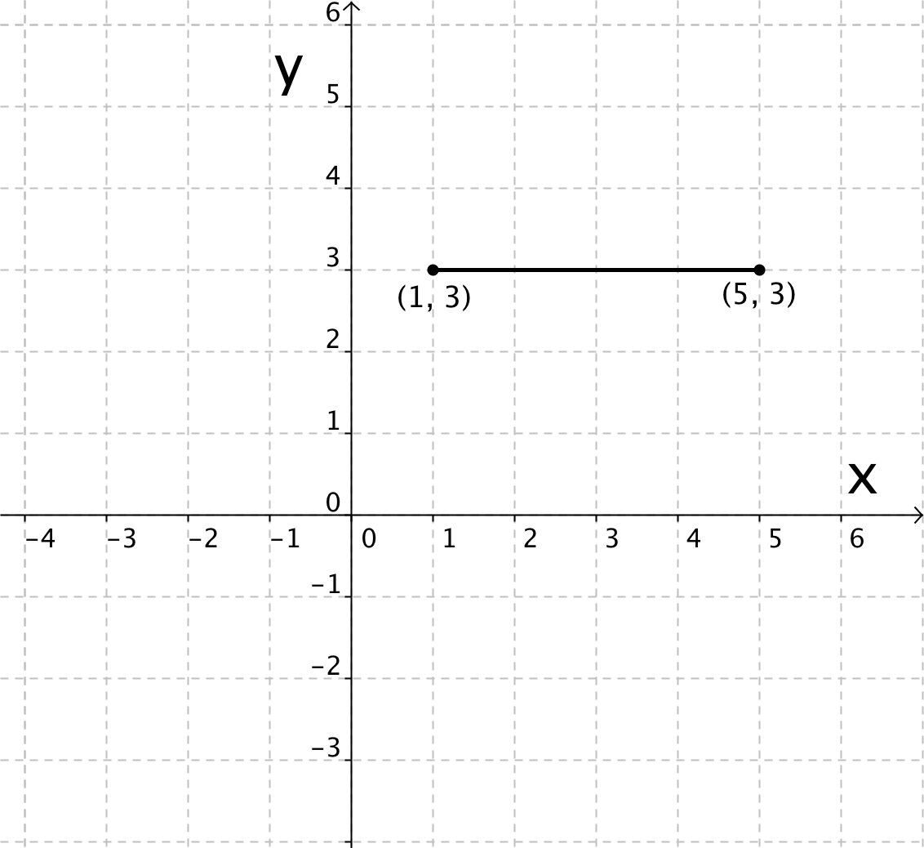
Warm Up
CONTENT OBJECTIVE: You will be able to measure the side lengths of a polygon on the coordinate plane without counting.
LANGUAGE OBJECTIVE: Students will talk about the x- and y-coordinates of points.
Find the length of the line segment.
Then write a paragraph explaining how you found the line segment. Be specific and include all details.
Answer
Version 2
Notes:
(Time on this slide – 4 min) Time passed 4 min
In-Class Notes
As students walk into class give them a copy of the Warm Up handout to complete.
The Warm Up is meant to review what they learned last class (namely, how to find the length of a line segment or polygon side using the coordinate plane as a tool) and to write a paragraph describing the process they use to measure length.
After 3 minutes have a student come up to the board and solve the problem.
Preparation Notes
It is recommended that the slides be projected on a whiteboard so that students may come up and write directly on the slides. If this is not possible then click the Answer button to get the solution.
Also note there is a second version of the Warm Up you may choose to use which has axes using a scale other than 1. This might be given as a challenge to some students or to the entire class to remind them of paying attention to the scale on the axes when using the coordinate plane to measure length.

Slide 7
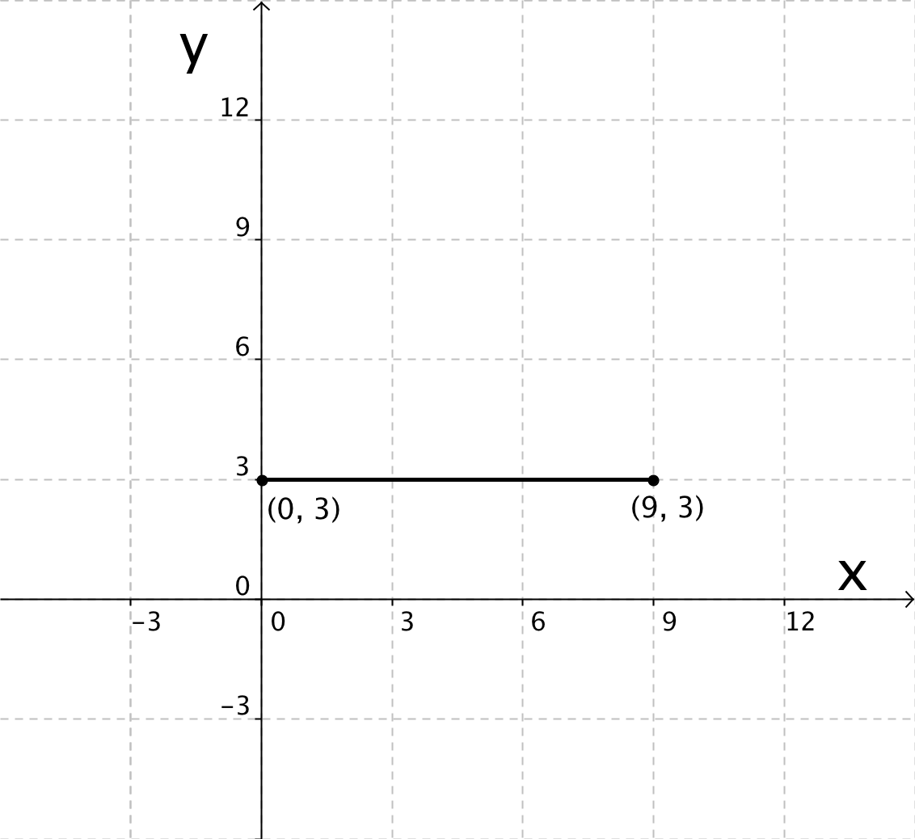
Warm Up (version 2)
CONTENT OBJECTIVE: You will be able to measure the side lengths of a polygon on the coordinate plane without counting.
LANGUAGE OBJECTIVE: Students will talk about the x- and y-coordinates of points.
Find the length of the line segment.
Then write a paragraph explaining how you found the line segment. Be specific and include all details.
Answer
Notes:
Use as directed in slide 8.

Slide 8
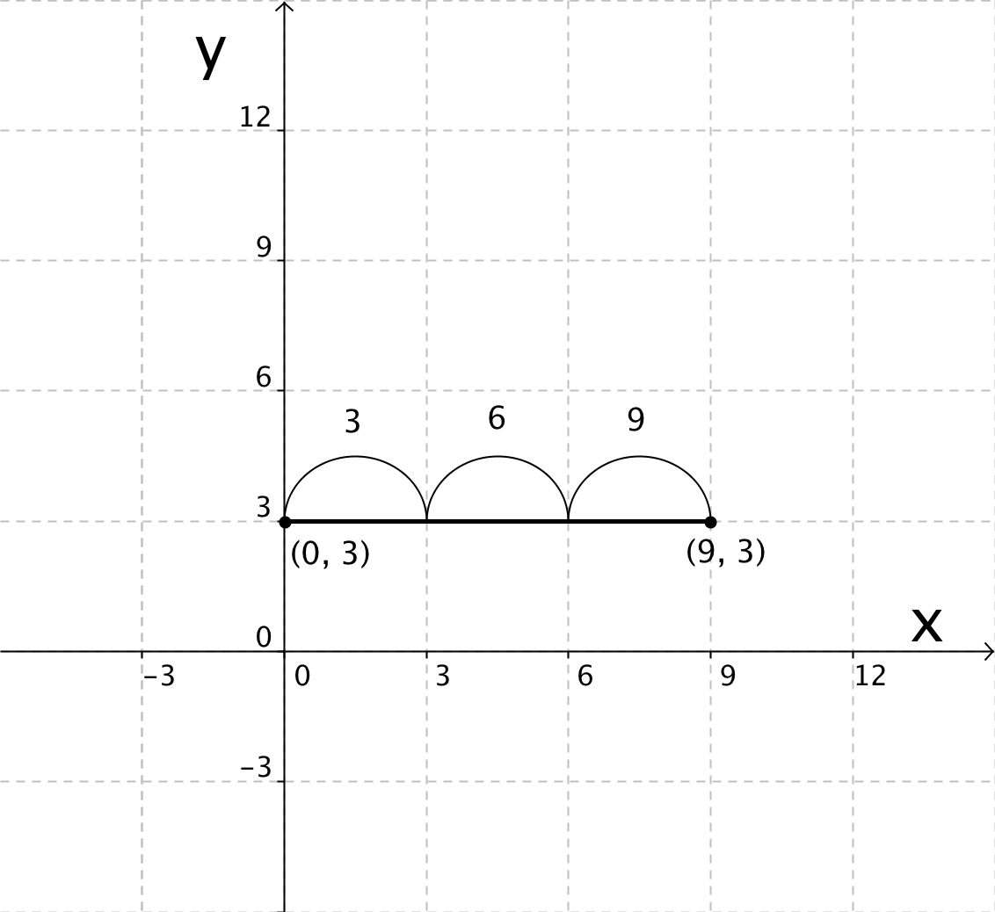
Warm Up (version 2, Answer)
CONTENT OBJECTIVE: You will be able to measure the side lengths of a polygon on the coordinate plane without counting.
LANGUAGE OBJECTIVE: Students will talk about the x- and y-coordinates of points.
Length = 9 units
Explanation:
Determine scale of axis. This tell you how to skip count.
Start at one endpoint and skip count to the other endpoint.
Jump from one gridline to the next till you reach the endpoint.
Version 2
Notes:
Use as directed in slide 8.

Slide 9
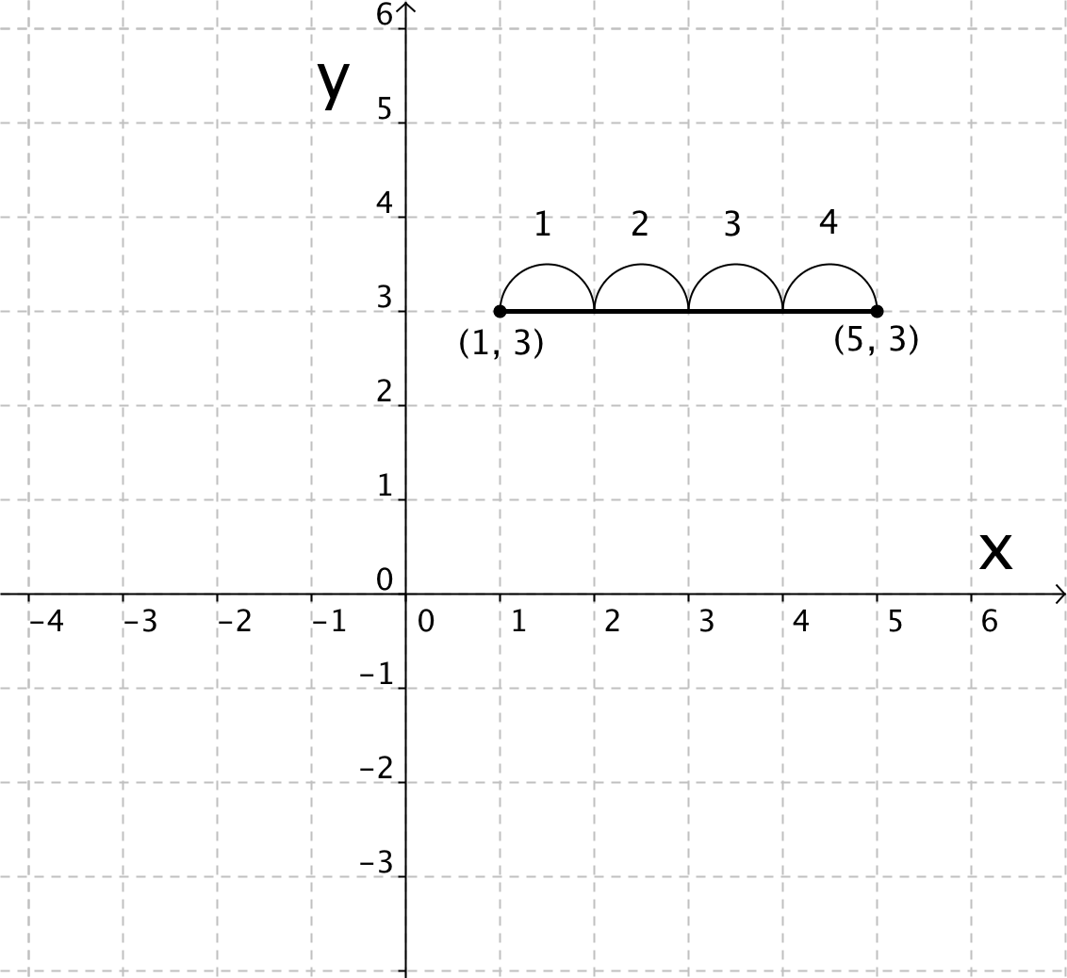
Warm Up (Answer)
CONTENT OBJECTIVE: You will be able to measure the side lengths of a polygon on the coordinate plane without counting.
LANGUAGE OBJECTIVE: Students will talk about the x- and y-coordinates of points.
Length = 4 units
Explanation:
Determine scale of axis. This tell you how to skip count.
Start at one endpoint and skip count to the other endpoint.
Jump from one gridline to the next till you reach the endpoint.
Version 2
Notes:
Use as directed in slide 8.

Slide 10
Agenda:
CONTENT OBJECTIVE: You will be able to measure the side lengths of a polygon on the coordinate plane without counting.
LANGUAGE OBJECTIVE: Students will talk about the x- and y-coordinates of points.
1) Warm Up (5 min, individual): Explain how to measure side length
2) Launch (15 min, whole class): New method for measuring side length
3) Explore/Practice (25 min, partner): Using both methods
4) Summary (5 min, whole class): Why (and when) use the new method?
5) Assessment (5 min, individual): Exit ticket
Notes:
(Time on this slide – 1 min) Time passed 5 min
In-Class Notes
Review the objectives and agenda with students.
Make sure to tell students that in this class they will be learning a second method
Preparation Notes

Slide 11
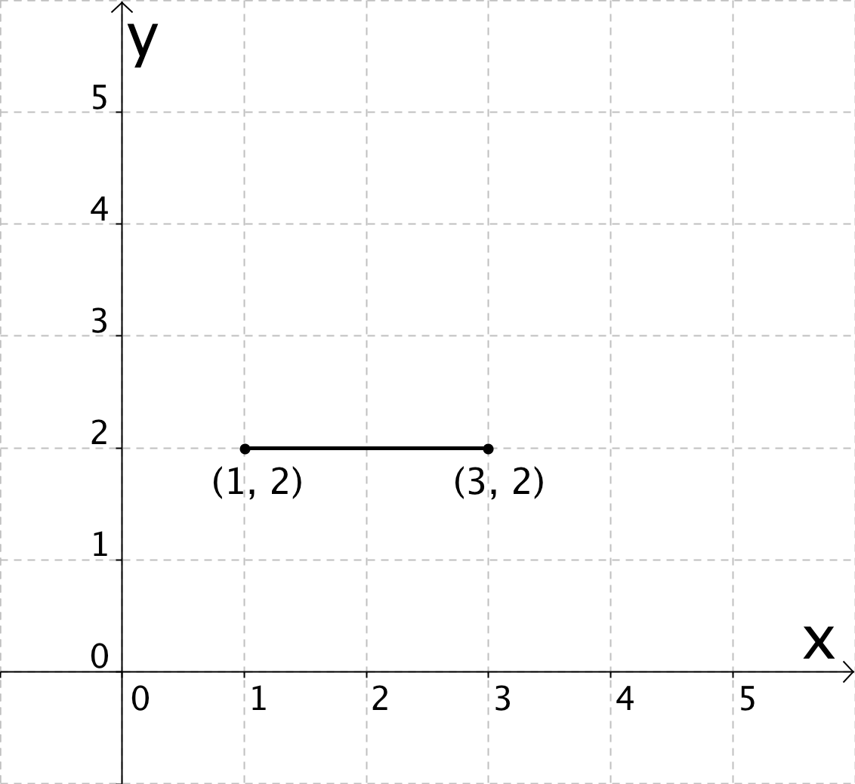
Handout: Launch, p.1
2 units
Agenda
Notes:
(Time on this slide - 1 min) Time passed 6 min
In-Class Notes
Give students the Launch handout.
Let the students know that they will find the length of several horizontal line segments using the method they learned in the last lesson (Method #1: Counting on the Coordinate Plane). Afterwards they will look more closely at the coordinates of points and come up with a second method together.
As a class find the length of the horizontal line segment.
Preparation Notes
Slides 13-15 all practice the method learned in the previous lesson. This method uses the coordinate plane as a tool and therefore promotes MP5: Use appropriate tools strategically.

Slide 12
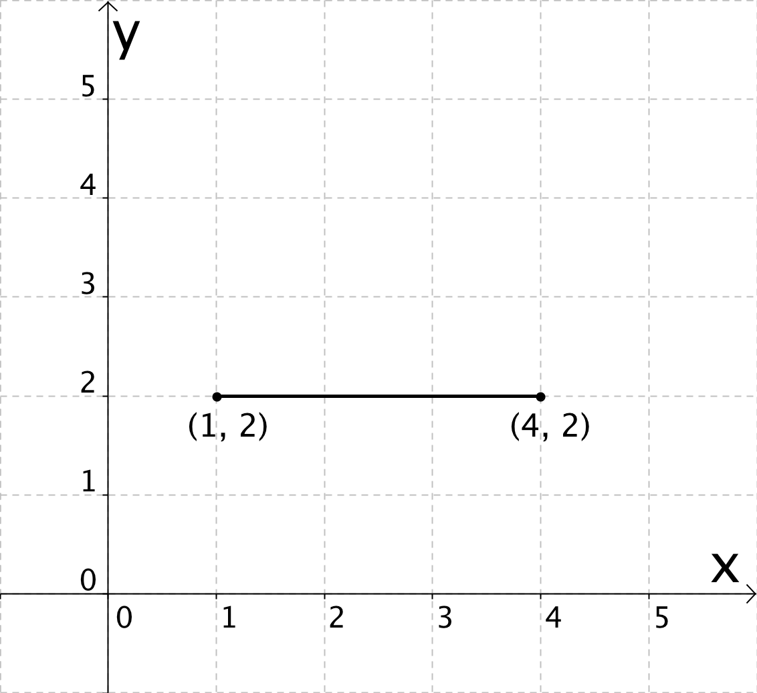
Handout: Launch, p.1
3 units
Agenda
Notes:
(Time on this slide - .5 min) Time passed 6.5
In-Class Notes
As a class find the length of the horizontal line segment.
Preparation Notes

Slide 13
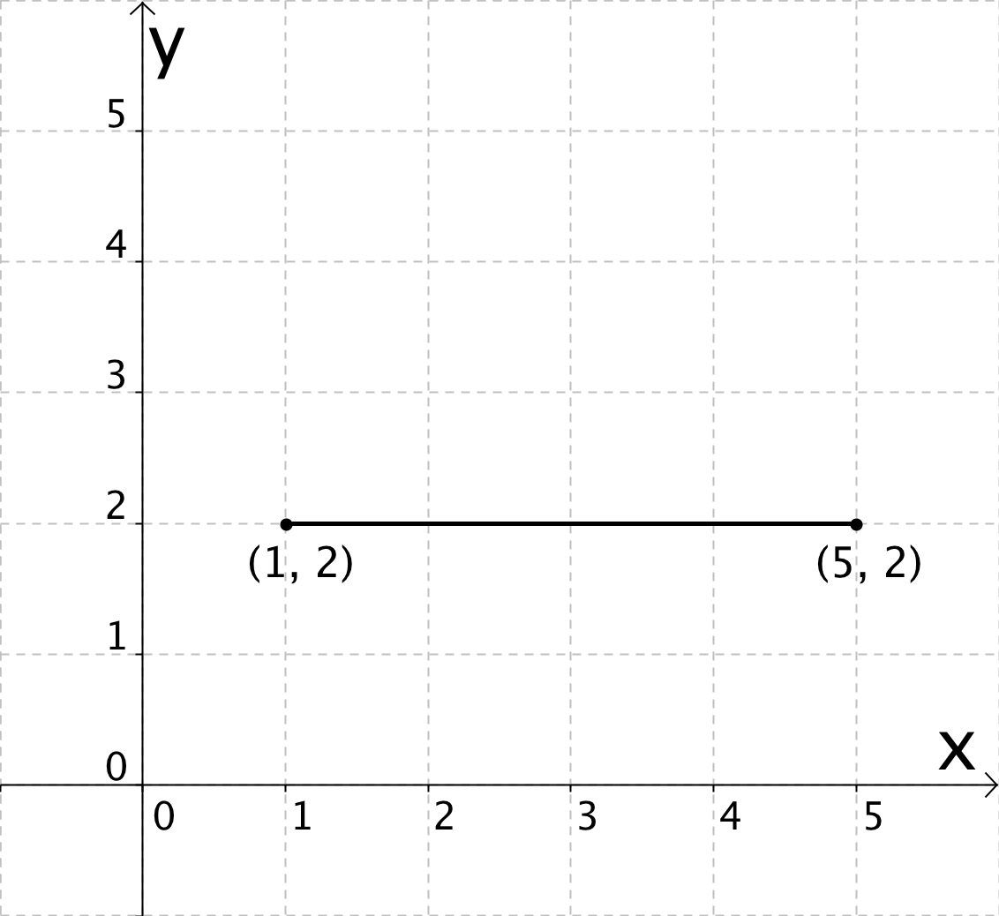
Handout: Launch, p.1
4 units
Agenda
Notes:
(Time on this slide – .5 min) Time passed 7 min
In-Class Notes
As a class find the length of the horizontal line segment.
Preparation Notes

Slide 14
Handout: Launch, p.1
Questions:
1. What coordinate stays the same in each of the three examples?
2. What coordinate changes in each of the three examples?
3. What is the relationship between the coordinate that changes and the length of the line segment?
(1,2)
(3,2)
(1,2)
(3,2)
2 units
3 – 1 = 2 units
Scaffold
Agenda
Notes:
(Time on this slide – 2 min) Time passed 9 min
In-Class Notes
Begin by directing students to the three questions at the bottom of page 1.
Using the first horizontal line segment as an example, answer the three questions for that particular example (e.g., in this example what coordinate stays the same). Student do not need to write down the answers yet since they will answer the questions more generally in the next slide.
Preparation Notes
If you want to do the same activity with the other two horizontal line segments on page 1 then hit the Scaffold button. This is meant as an extra support if students need to repeat the same line of reasoning with other examples before they are able to generalize some ideas for slide 19.

Slide 15
Handout: Launch, p.1
Questions:
1. What coordinate stays the same in each of the three examples?
2. What coordinate changes in each of the three examples?
3. What is the relationship between the coordinate that changes and the length of the line segment?
(1,2)
(4,2)
(1,2)
(4,2)
3 units
4 – 1 = 3 units
Agenda
Notes:
Use as directed in slide 16.

Slide 16
Handout: Launch, p.1
Questions:
1. What coordinate stays the same in each of the three examples?
2. What coordinate changes in each of the three examples?
3. What is the relationship between the coordinate that changes and the length of the line segment?
(1,2)
(5,2)
(1,2)
(5,2)
4 units
5 – 1 = 4 units
Agenda
Notes:
Use as directed in slide 16.

Slide 17
Handout: Launch, p.1
Questions:
1. What coordinate stays the same in each of the three examples?
2. What coordinate changes in each of the three examples?
3. What is the relationship between the coordinate that changes and the length of the line segment?
Answer
Agenda
Notes:
(Time on this slide – 1 min) Time passed 10 min
In-Class Notes
Call on students to answer each of the three questions. Have them give answers that are general and not tied to a specific example as they had done on slides 16-18.
Write down their answers on the whiteboard and have students copy the answers down in their notes.
Preparation Notes
Having students generalize a process or observation promotes MP 2: Reason abstractly and quantitatively. Doing this through the use of multiple examples prior to generalizing can also support MP 8: Look for and express regularity in repeated reasoning.
If you cannot record students answers on a white board then click the Answer button.

Slide 18
Handout: Launch, p.1
Questions:
1. What coordinate stays the same in each of the three examples?
2. What coordinate changes in each of the three examples?
3. What is the relationship between the coordinate that changes and the length of the line segment?
The y-coordinate was the same in each example.
The x-coordinate changed in each example.
If you subtract the coordinates the smaller x-coordinate from the larger one you get the length of the line segment.
Agenda
Notes:
Use as indicated on slide 19.

Slide 19
Handout: Launch, p.1
3 – 1 =
2
2 units
Agenda
Notes:
(Time on this slide – .5 min) Time passed 10.5 min
In-Class Notes
Go over the length of the first horizontal line segment which was found using Method #1.
Using the relationship found between the coordinate that changes and the line segment length, calculate the length of the line segment using Method #2.
Check that the answers matches using the two methods.
Preparation Notes
This first horizontal line segment may take some support from you to get students to understand and use Method #2. Tying an observation made to a new procedure might take some teacher direction. However this practice of using different strategies and showing that they all make sense and provide the same result is an opportunity for students to experience MP 1: Make sense of problems and persevere in solving them.

Slide 20
Handout: Launch, p.1
4 – 1 =
3
3 units
Agenda
Notes:
(Time on this slide - .5 min) Time passed 11 min
In-Class Notes
Go over the length of the second horizontal line segment which was found using Method #1.
Using the relationship found between the coordinate that changes and the line segment length, calculate the length of the line segment using Method #2.
Check that the answers matches using the two methods.
Preparation Notes
Again this practice of using different strategies and showing that they all make sense and provide the same result is an opportunity for students to experience MP 1: Make sense of problems and persevere in solving them.

Slide 21
Handout: Launch, p.1
5 – 1 =
4
4 units
Agenda
Notes:
(Time on this slide - .5 min) Time passed 11.5 min
In-Class Notes
Go over the length of the third horizontal line segment which was found using Method #1.
Using the relationship found between the coordinate that changes and the line segment length, calculate the length of the line segment using Method #2.
Check that the answers matches using the two methods.
Preparation Notes
Again this practice of using different strategies and showing that they all make sense and provide the same result is an opportunity for students to experience MP 1: Make sense of problems and persevere in solving them.

Slide 22
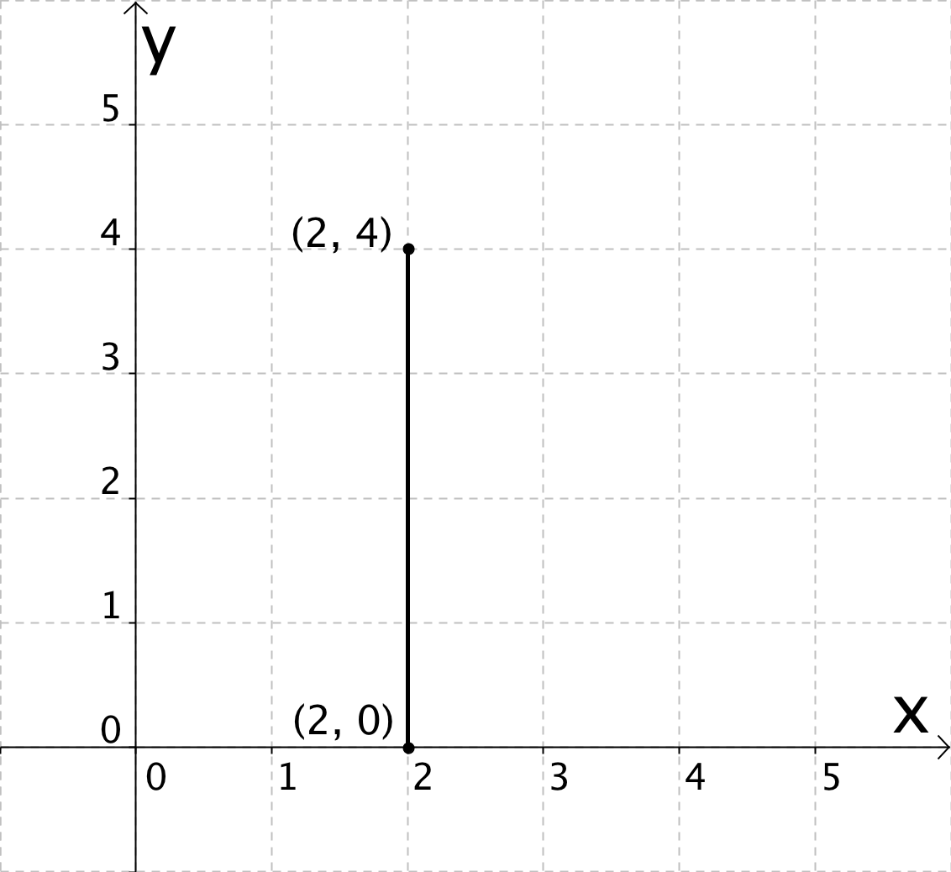
Handout: Launch, p.2
4 units
Agenda
Notes:
(Time on this slide - .5 min) Time passed 12 min
In-Class Notes
As a class find the length of the vertical line segment.
Preparation Notes
Again this is an opportunity for students to use the method they learned in the previous lesson and to engage in MP 5: Use appropriate tools strategically.

Slide 23
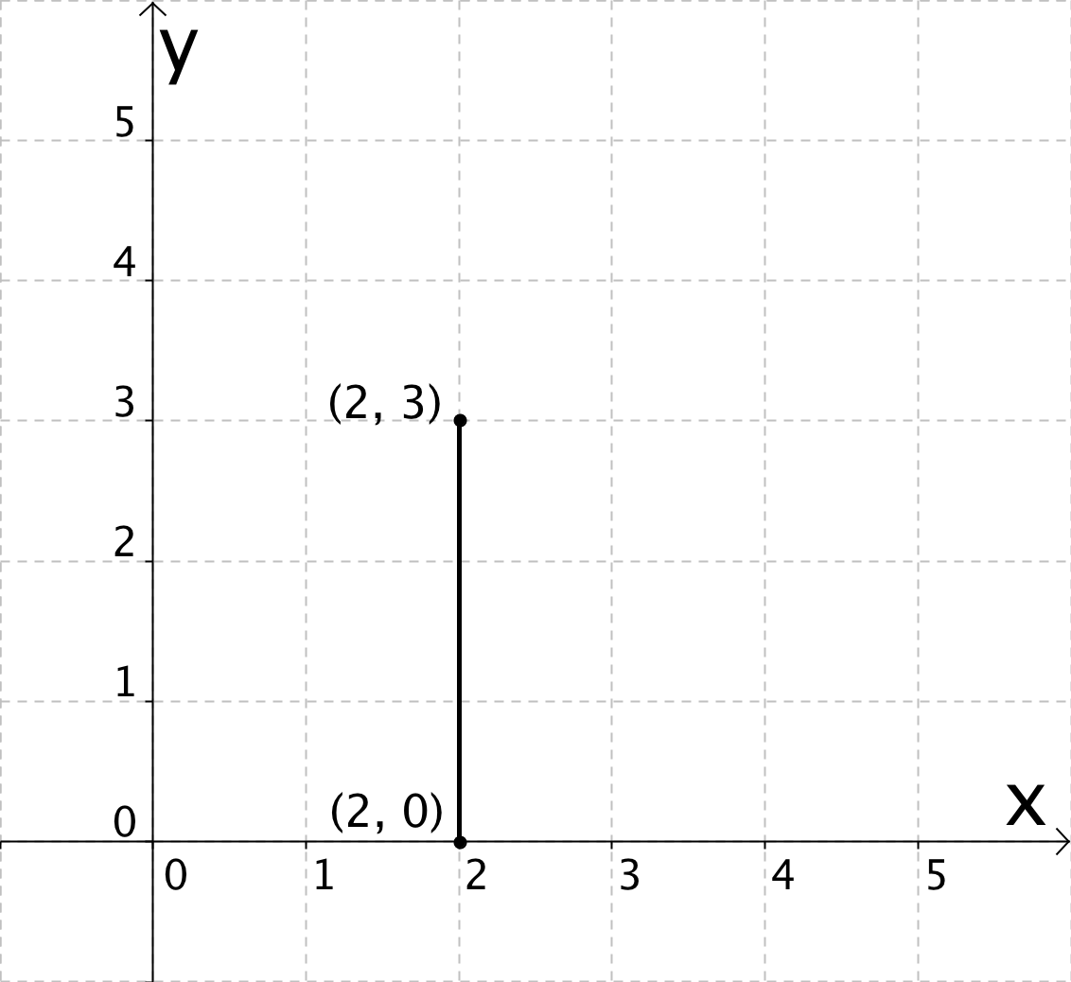
Handout: Launch, p.2
3 units
Agenda
Notes:
(Time on this slide - .5 min) Time passed 12.5 min
In-Class Notes
As a class find the length of the vertical line segment.
Preparation Notes

Slide 24
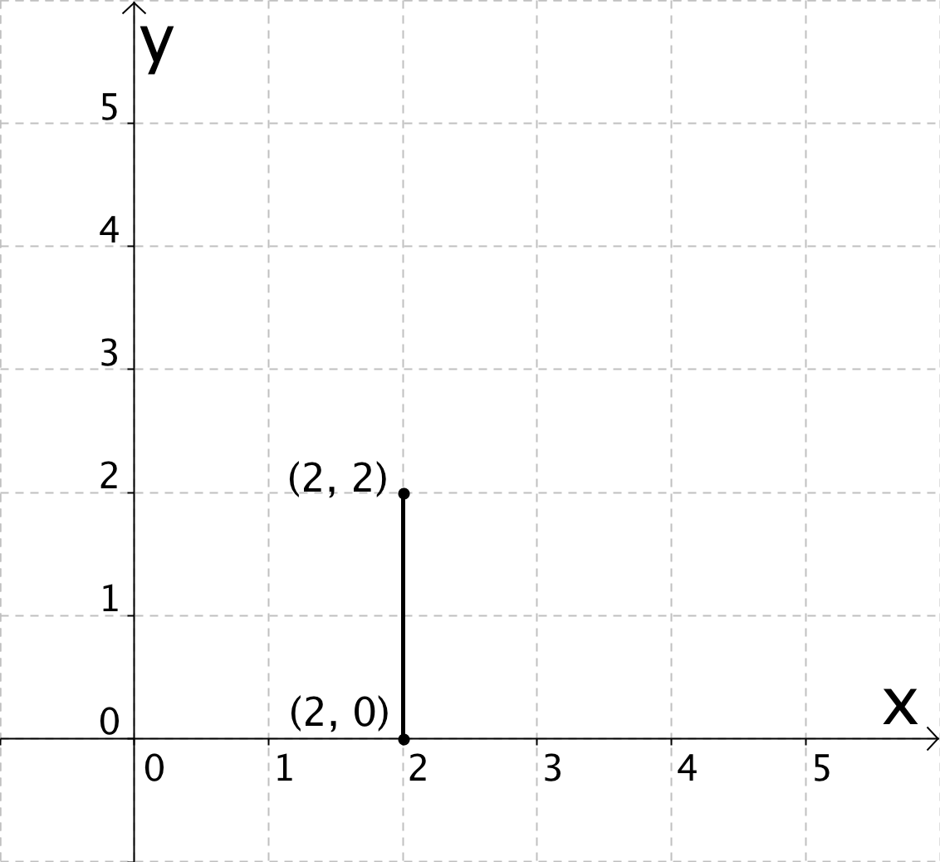
Handout: Launch, p.2
2 units
Agenda
Notes:
(Time on this slide – .5 min) Time passed 13 min
In-Class Notes
As a class find the length of the vertical line segment.
Preparation Notes

Slide 25
Handout: Launch, p.2
Questions:
1. What coordinate stays the same in each of the three examples?
2. What coordinate changes in each of the three examples?
3. What is the relationship between the coordinate that changes and the length of the line segment?
(2,4)
(2,4)
4 units
(2,0)
(2,0)
4 – 0 = 4 units
Scaffold
Agenda
Notes:
(Time on this slide – 1 min) Time passed 14 min
In-Class Notes
Begin by directing students to the three questions at the bottom of page 2.
Using the first vertical line segment as an example, answer the three questions for that particular example (e.g., in this example what coordinate stays the same). Student do not need to write down the answers yet since they will answer the questions more generally in the next slide.
Preparation Notes
If you want to do the same activity with the other two vertical line segments on page 2 then hit the Scaffold button. This is meant as an extra support if students need to repeat the same line of reasoning with other examples before they are able to generalize some ideas for slide 30.

Slide 26
Handout: Launch, p.2
Questions:
1. What coordinate stays the same in each of the three examples?
2. What coordinate changes in each of the three examples?
3. What is the relationship between the coordinate that changes and the length of the line segment?
(2,3)
(2,3)
3 units
(2,0)
(2,0)
3 – 0 = 3 units
Agenda
Notes:
Use as directed in slide 27.

Slide 27
Handout: Launch, p.2
Questions:
1. What coordinate stays the same in each of the three examples?
2. What coordinate changes in each of the three examples?
3. What is the relationship between the coordinate that changes and the length of the line segment?
(2,2)
(2,2)
2 units
(2,0)
(2,0)
2 – 0 = 2 units
Agenda
Notes:
Use as directed in slide 27.

Slide 28
Handout: Launch, p.2
Questions:
1. What coordinate stays the same in each of the three examples?
2. What coordinate changes in each of the three examples?
3. What is the relationship between the coordinate that changes and the length of the line segment?
Answer
Agenda
Notes:
(Time on this slide – 1 min) Time passed 15 min
In-Class Notes
Call on students to answer each of the three questions. Have them give answers that are general and not tied to a specific example as they had done on slides 27-29.
Write down their answers on the whiteboard and have students copy the answers down in their notes.
Preparation Notes
Having students generalize a process or observation promotes MP 2: Reason abstractly and quantitatively. Doing this through the use of multiple examples prior to generalizing can also support MP 8: Look for and express regularity in repeated reasoning.
If you cannot record students answers on a white board then click the Answer button.

Slide 29
Handout: Launch, p.2
Questions:
1. What coordinate stays the same in each of the three examples?
2. What coordinate changes in each of the three examples?
3. What is the relationship between the coordinate that changes and the length of the line segment?
The x-coordinate was the same in each example.
The y-coordinate changed in each example.
If you subtract the coordinates the smaller y-coordinate from the larger one you get the length of the line segment.
Agenda
Notes:
Use the slide as indicated in slide 30.

Slide 30
Handout: Launch, p.2
4 – 0 =
4
4 units
Agenda
Notes:
(Time on this slide - .5 min) Time passed 15.5 min
In-Class Notes
Go over the length of the first vertical line segment which was found using Method #1.
Using the relationship found between the coordinate that changes and the line segment length, calculate the length of the line segment using Method #2.
Check that the answers matches using the two methods.
Preparation Notes
Again this practice of using different strategies and showing that they all make sense and provide the same result is an opportunity for students to experience MP 1: Make sense of problems and persevere in solving them.

Slide 31
Handout: Launch, p.2
3 – 0 =
3
3 units
Agenda
Notes:
(Time on this slide - .5 min) Time passed 16 min
In-Class Notes
Go over the length of the second vertical line segment which was found using Method #1.
Using the relationship found between the coordinate that changes and the line segment length, calculate the length of the line segment using Method #2.
Check that the answers matches using the two methods.
Preparation Notes
Again this practice of using different strategies and showing that they all make sense and provide the same result is an opportunity for students to experience MP 1: Make sense of problems and persevere in solving them.

Slide 32
Handout: Launch, p.2
2 – 0 =
2
2 units
Agenda
Notes:
(Time on this slide - .5 min) Time passed 16.5 min
In-Class Notes
Go over the length of the third vertical line segment which was found using Method #1.
Using the relationship found between the coordinate that changes and the line segment length, calculate the length of the line segment using Method #2.
Check that the answers matches using the two methods.
Preparation Notes
Again this practice of using different strategies and showing that they all make sense and provide the same result is an opportunity for students to experience MP 1: Make sense of problems and persevere in solving them.

Slide 33
Standards for This Unit
The lesson that you are currently looking at is part of a unit that teaches the following Common Core Standards:
6.G.A.3. Draw polygons in the coordinate plane given coordinates for the vertices; use coordinates to find the length of a side joining points with the same first coordinate or the same second coordinate. Apply these techniques in the context of solving real-world and mathematical problems.
Next Slide
Back to Overview

