Slide 1



Additive Opposites

Slide 2
Lesson Overview (1 of 4)
Lesson Objective | SWBAT identify additive inverses as reflections about zero on a number line. Language Objective: Students will be familiar with the words additive identity, and opposite, and understand the properties of these words.
Lesson Description | The lesson begins with a review on number lines as a do now. After, it goes right into defining additive identity and opposite. There are a few practice problems to make sure students understand these vocabulary words. The heart of the lesson is in the exploration. Students will be guided to understanding where the name opposite comes from, and why they are important in math. Following the exploration, a summary of what students found will take place, proceeded by practice and an individual exit ticket. Homework is also provided to further enhance students understanding.

Slide 3
Lesson Overview (2 of 4)
Lesson Vocabulary | Additive identity - When any number is added to the additive identity, that number remains unchanged. Zero is the additive identity in the real number system. Opposite – Also known as additive inverse, two opposites are on reverse sides of zero on a number line.
Materials | Handouts Paper Scissors (Optional) Ruler (Optional)
Common Core State Standard | 6.NS.6a. Recognize opposite signs of numbers as indicating locations on opposite sides of 0 on the number line; recognize that the opposite of the opposite of a number is the number itself, e.g., –(–3) = 3, and that 0 is its own opposite.

Slide 4
Lesson Overview (3 of 4)
Scaffolding | There are handouts available for the practice at the beginning of the lesson which includes space to write vocabulary if the student is in need for this extra handout.
Enrichment | There is a challenging bonus question on the exit slip, as well as optional questions on the homework for students who have mastered the standard objective. In class, it would be wise for these students to lead the discussions when prompting students to think about opposites on a number line.
Online Resources for Absent Students | http://www.flaslet.com/math/practice/7087/additive-inverse-of-a-rational-number This website provides an interactive “Quiz” on additive opposites. It gives an explanation to students when problems are answered incorrectly.

Slide 5
Lesson Overview (4 of 4)
Before and After | Before: Students will need to have a clear idea of how to plot rational numbers on a number line. After: Students will be familiar with the additive identity, and the relative positions of opposites in regards to the additive identity. Students will begin to practice with the idea of adding integers.
Topic Background | Include any or all of these: a) interesting historical facts related to the day’s objective, b) how the lesson’s mathematics is used in the real world, and c) a brief description of the research supporting the practices used in the lesson (sometimes with a link to the source).

Slide 6

Warm Up
OBJECTIVE: SWBAT identify opposites as reflections about zero on a number line.
Language Objective: Students will be able to perform operations with opposites, and identify the additive identity.
Quick Review: You are a carpenter, and need to make some cuts! Place each measurement on the ruler as accurately as possible.
7/8’’
1 15/16’’
3 1/2’’
4’’
1) 4’’ 2) 3 1/2’’
3) 7/8’’ 4) 1 15/16’’
Agenda
Notes:
(5 - min) 0-5
In-Class Notes
This problem is designed to make sure all the students are familiar with a number line, and can place rational numbers on a number line. Now would be a great time to make sure all the students are up to speed.
good strategies for students to apply is to imagine evenly spaces lines in between the two whole numbers for each fraction. For example, on 3 ½ imagine two spaces in between 3 and 4, and for 1 15/16, imagine 16 even spaces between 1 and 2.
Preparation Notes
Be prepared to spend a little extra time on the warm up, just in case some people haven't mastered this skill yet.

Slide 7
Agenda:
OBJECTIVE: SWBAT identify opposites as reflections about zero on a number line.
Language Objective: Students will be able to perform operations with opposites, and identify the additive identity.
1) Warm Up – Quick Review
2) Launch – Additive identity and opposites
3) Explore – Opposites on the number line
4) Summary – Opposites and Reflections
5) Practice – Putting everything together!
6) Assessment – Exit Slip
Notes:
(1- min) 5-6

Slide 8

Launch
What do you think of when you think of the word identity?
In plain English, identity means: Being who or what a person or thing is.
In Mathematics, we have something called an additive identity.
When you add any number to the additive identity, you get back what that thing is. In this case, the thing is a number!
Agenda
Notes:
(2- min) 6-8
In-Class Notes
have students copy these notes into a notebook.
If students are having trouble, they can request the scaffolding vocabulary worksheet.
Preparation Notes
Make sure you have some of the scaffolding vocabulary worksheets printed out in case some students need them.

Slide 9
Launch – Additive Identity Example
Example of additive identities: What number can we add to 5 to get back 5?
5 + = 5
?
0
Zero is the Additive Identity!
When you add zero to ANY number, you get back that number!
Can you think of another example of addition with the additive identity?
Agenda
Notes:
(2 - min) 8-10
In-Class Notes
have students copy these notes into a notebook.
If students are having trouble, they can request the scaffolding vocabulary worksheet.
Have the students discuss out loud other examples for addition with the additive identity.
Preparation Notes
Make sure you have some of the scaffolding vocabulary worksheets printed out in case some students need them.

Slide 10

Launch
What do you think of when you think of the word opposite?
In plain English, opposite means: Having a position on the reverse side of something or someone.
In Mathematics, every number has an opposite.
Two numbers that are the same with opposite signs are known as opposites.
For example, 5 and -5 are opposites.
Agenda
Notes:
(2- min) 10-12
In-Class Notes
have students copy these notes into a notebook.
If students are having trouble, they can request the scaffolding vocabulary worksheet.
Preparation Notes
Make sure you have some of the scaffolding vocabulary worksheets printed out in case some students need them.

Slide 11
Launch
What do we get when we add two opposites?
0
5 +(-5)=
?
*Remember!*
Zero is the additive identity!
When you add two opposites, you get the additive identity!
Can you think of two other numbers that are opposites?
Agenda
Notes:
(2 - min) 12-14
In-Class Notes
have students copy these notes into a notebook.
If students are having trouble, they can request the scaffolding vocabulary worksheet.
Have the students discuss out loud other examples for opposites.
Remind the students from slide 11 that zero IS the additive identity.
Preparation Notes
Make sure you have some of the scaffolding vocabulary worksheets printed out in case some students need them.

Slide 12
Launch
Find the opposites for the following numbers, so they add up to the additive identity:
1) 12 and ____
-12
3
2) -3 and ____
12 + (-12) = 0
-3 + 3 = 0
- ¾
0
3) ¾ and ____
4) 0 and ____
Remember!
-0 = 0
¾ + (- ¾ ) = 0
0 + 0 = 0
5) Bonus – What is the opposite of an opposite?
(For example -(-5)?)
You end up back with the original number! -(-5) = 5!
Agenda
Notes:
(5 - min) 14-19
In-Class Notes
have students copy these notes into a notebook.
If students are having trouble, they can request the scaffolding vocabulary worksheet.
Preparation Notes
Make sure you have some of the scaffolding vocabulary worksheets printed out in case some students need them.

Slide 13
Launch
Where does the name opposite come from?
We are going to explore this question with a partner, and try to come up with the answer on our own!
Agenda
Notes:
(1- min) 19-20
In-Class Notes
This is the launch for the exploration. Let the students try to answer the question, then suggest everyone works on this problem through a set of questions that you hand out.
Preparation Notes
You should pay attention to answers such as “opposites are on exact different locations,” or “opposites have reverse locations,” etc. Let the students who answer in such a manner know they are on the right track, but try not to spend to much time on this question – it is more rhetorical to lead into the exploration.

Slide 14



Explore
Click on the timer!
Work with your partner. You will see five examples of opposites. Plot them on the number lines given.
You will get a worksheet a ruler and some number lines.
You should:
  Read each scenario
  Plot the points on the number line
  Answer the questions!
1-Partners
2-Share Out
3-Discussion
In 10 minutes you will be asked to stop and present!
Agenda
Notes:
Online timer link on slide – (10 min) (20-30)
In-Class Notes
Pass out “Explore” Classwork, Calculator.
Focus on strategies and help struggling pairs recall previous techniques
click the timer to give a 10 minute countdown.

Slide 15

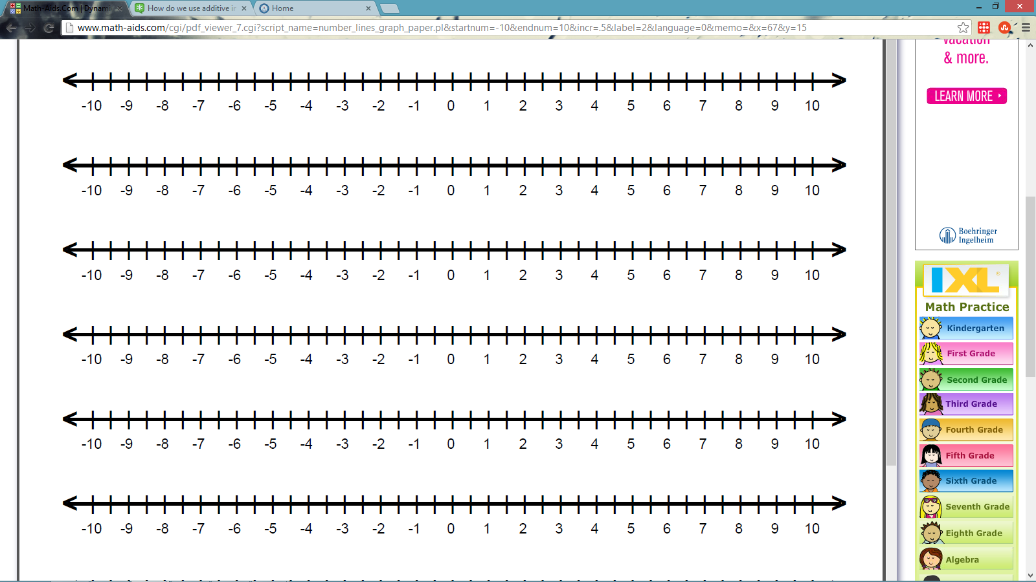
Explore
Example: You have $10.
You owe the pizza delivery boy $10.
a) Plot 10 and -10 on a number line.
b) Draw a line from 10 to 0, and a line from -10 to 0.
c) Fold the number line at 0 to compare the length of each line.
Agenda
Notes:
(2- min) 30-32
In-Class Notes
This example is provided to guide the students through the rest of the exploration. Take this time to answer any questions and clarify any uncertainties about directions.
Preparation Notes
This slide should be shown once the explore worksheet is passed out, before the students start working.

Slide 16
Explore – Student Share Out
Discussion - (5 Min)
Students share out work.
Make sure to ask questions for anything you are unsure about!
Classwork Questions
Agenda
Notes:
(1 min) 32-33
In-Class Notes
The summary goes over what everyone just explored on the last worksheet. Try to have a student based discussion during the next slides, especially once you get to question 6.
Use question 6 to prompt students to answer what they have learned about opposites by answering these questions.
Preparation Notes
If students are a little shy about answering, go over the problems together, and have them just discuss problem six as a class.

Slide 17

Explore
1) You go to the store and want three apples.
The store has three apples that you plan to buy!
a) Plot the points 3 and -3 on the number line
b) Draw a line from 3 to 0, and a line from -3 to 0.
c) Fold the number line at 0 to compare the length of each line.
Agenda
Notes:
(1 min) 33-34
In-Class Notes
The purpose of these questions is just to get the students to see opposites plotted on a number line. Any observations they make about the opposites will be useful. The final goal is to realize that all opposites are the same distance from zero (Have the same absolute value). This will prepare them for math classes in the future that will have a strong emphasis on absolute value.
The summary goes over what everyone just explored on the last worksheet. Try to have a student based discussion during the next slides, especially once you get to question 6.
Use question 6 to prompt students to answer what they have learned about opposites by answering these questions.
Preparation Notes
If students are a little shy about answering, go over the problems together, and have them just discuss problem six as a class.

Slide 18
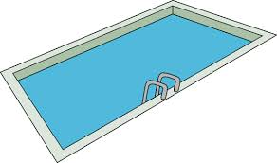
Explore
2) You stand on a diving board that is 6.5 feet high.
When you dive off, you go down 6.5 feet under water.
a) Plot the points -6.5 and 6.5 on the number line
b) Draw a line from -6.5 to 0, and a line from 6.5 to 0.
c) Fold the number line at 0 to compare the length of each line.
Agenda
Notes:
(1 min) 34-35
In-Class Notes
The purpose of these questions is just to get the students to see opposites plotted on a number line. Any observations they make about the opposites will be useful. The final goal is to realize that all opposites are the same distance from zero (Have the same absolute value). This will prepare them for math classes in the future that will have a strong emphasis on absolute value.
The summary goes over what everyone just explored on the last worksheet. Try to have a student based discussion during the next slides, especially once you get to question 6.
Use question 6 to prompt students to answer what they have learned about opposites by answering these questions.
Preparation Notes
If students are a little shy about answering, go over the problems together, and have them just discuss problem six as a class.

Slide 19

Explore
3) You need 3 ¼ cups of flour to bake a cake.
Your neighbor has 3 ¼ cups that you can borrow.
a) Plot the points 3 ¼ and -3 ¼ on the number line
b) Draw a line from 3 ¼ to 0, and a line from -3 ¼ to 0.
c) Fold the number line at 0 to compare the length of each line.
Agenda
Notes:
(1 min) 35-36
In-Class Notes
The purpose of these questions is just to get the students to see opposites plotted on a number line. Any observations they make about the opposites will be useful. The final goal is to realize that all opposites are the same distance from zero (Have the same absolute value). This will prepare them for math classes in the future that will have a strong emphasis on absolute value.
The summary goes over what everyone just explored on the last worksheet. Try to have a student based discussion during the next slides, especially once you get to question 6.
Use question 6 to prompt students to answer what they have learned about opposites by answering these questions.
Preparation Notes
If students are a little shy about answering, go over the problems together, and have them just discuss problem six as a class.

Slide 20

Explore
4) You ride your bike 3.75 miles to a friend’s house.
You ride your bike 3.75 miles in the opposite direction to get back home.
a) Plot the points 3.75 and -3.75 on the number line
b) Draw a line from 3.75 to 0, and a line from -3.75 to 0.
c) Fold the number line at 0 to compare the length of each line.
Agenda
Notes:
(1 min) 36-37
In-Class Notes
The purpose of these questions is just to get the students to see opposites plotted on a number line. Any observations they make about the opposites will be useful. The final goal is to realize that all opposites are the same distance from zero (Have the same absolute value). This will prepare them for math classes in the future that will have a strong emphasis on absolute value.
The summary goes over what everyone just explored on the last worksheet. Try to have a student based discussion during the next slides, especially once you get to question 6.
Use question 6 to prompt students to answer what they have learned about opposites by answering these questions.
Preparation Notes
If students are a little shy about answering, go over the problems together, and have them just discuss problem six as a class.

Slide 21

Explore
5) A friend let’s you borrow $7.50.
You pay her back all $7.50 a week later.
a) Plot the points -7.50 and 7.50 on the number line
b) Draw a line from -7.50 to 0, and a line from 7.50 to 0.
c) Fold the number line at 0 to compare the length of each line.
Agenda
Notes:
(1 min) 37-38
In-Class Notes
The purpose of these questions is just to get the students to see opposites plotted on a number line. Any observations they make about the opposites will be useful. The final goal is to realize that all opposites are the same distance from zero (Have the same absolute value). This will prepare them for math classes in the future that will have a strong emphasis on absolute value.
The summary goes over what everyone just explored on the last worksheet. Try to have a student based discussion during the next slides, especially once you get to question 6.
Use question 6 to prompt students to answer what they have learned about opposites by answering these questions.
Preparation Notes
If students are a little shy about answering, go over the problems together, and have them just discuss problem six as a class.

Slide 22
Summary
6a) Name two things that each pair of opposites have in common.
They are both the same distance from zero!
The negative ones are always to the left of zero!
The positive ones are always to the right of zero!
Did anyone come up with any others?
Agenda
Notes:
(1 min) 38-39
In-Class Notes
The summary goes over what everyone just explored on the last worksheet. Try to have a student based discussion during the next slides, especially once you get to question 6.
Use question 6 to prompt students to answer what they have learned about opposites by answering these questions.
Preparation Notes
If students are a little shy about answering, go over the problems together, and have them just discuss problem six as a class.

Slide 23
Summary
6b) What do you notice about the length of the lines from each opposite to 0?
They “have a position on the reverse side of zero.”
Remember the definition of opposite from earlier? – “Having a position on the reverse side of something or someone.”
This is where the name opposite comes from!
Agenda
Notes:
(1 min) 39-40
In-Class Notes
If students are confused about “reverse side,” give them a visual example such as people lined up on a football field, or someone looking in to a mirror.
The summary goes over what everyone just explored on the last worksheet. Try to have a student based discussion during the next slides, especially once you get to question 6.
Use question 6 to prompt students to answer what they have learned about opposites by answering these questions.
Preparation Notes
If students are a little shy about answering, go over the problems together, and have them just discuss problem six as a class.

Slide 24
Summary
6b) What do you notice about the length of the lines from each opposite to 0?
Imagine a mirror right down the line at zero.
Then, two opposites would be reflections of each other!
In math language, we say that opposites are:
Reflections about zero.
Agenda
Notes:
(1 min) 40-41
In-Class Notes
Students should definitely write down the bullet points on this slide!
The summary goes over what everyone just explored on the last worksheet. Try to have a student based discussion during the next slides, especially once you get to question 6.
Use question 6 to prompt students to answer what they have learned about opposites by answering these questions.
Preparation Notes
If students are a little shy about answering, go over the problems together, and have them just discuss problem six as a class.

Slide 25
Summary
6c) How are opposites and the additive identity related?
Opposites are always the same distance from the additive identity, but on reverse sides.
Additive opposites add up to the additive identity.
0
5 +(-5)=
For any number a, a + (-a) = 0
Agenda
Notes:
(1 min) 41-42
In-Class Notes
The summary goes over what everyone just explored on the last worksheet. Try to have a student based discussion during the next slides, especially once you get to question 6.
Use question 6 to prompt students to answer what they have learned about opposites by answering these questions.
Preparation Notes
If students are a little shy about answering, go over the problems together, and have them just discuss problem six as a class.

Slide 26
Practice
1. Identify the additive opposite of the number, and then plot them both on a number line:
a) 9 and _____
b) -7.5 and _____
c) 4.25 and ____
-9
7.5
-4.25
Agenda
Notes:
(3 - min) 42-45
In-Class Notes
You can choose to have the students answer the questions individually, or with a partner, and then go over the answers, or you can work on the practice as a class. The slides directly reflect the class work.
Preparation Notes
Print out enough class work practice worksheets for everyone in the class to have one.

Slide 27
Practice
2. Evaluate the following:
a) 8 + (-8) = b) 14.6 + 0 =
c) -4 + 4 = d) - (-13) =
e) 9.6 + (-9.6) = f) 0 + (-3.2) =
g) -17 ½ + 0 = h) – (-3 ¼ ) =
0
14.6
0
13
0
3.2
-17 ½
3 ¼
Agenda
Notes:
(3 - min) 45-48
In-Class Notes
You can choose to have the students answer the questions individually, or with a partner, and then go over the answers, or you can work on the practice as a class. The slides directly reflect the class work.
Preparation Notes
Print out enough class work practice worksheets for everyone in the class to have one.

Slide 28
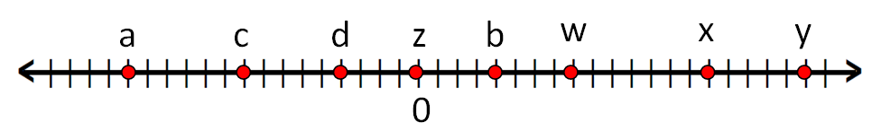
Practice
b
a) What letter represents the opposite of d?_________________________________
b) What letter represents the opposite of x?_________________________________
c) What letter represents the opposite of c?_________________________________
d) What letter represents the opposite of –y?________________________________
(Careful! –y is not shown on the number line.)
e) What letter represents the opposite of z?__________________________________
a
w
Remember!
-(-y) = y
y
Remember!
-0 = 0
z
Agenda
Notes:
(3 - min) 48-51
In-Class Notes
You can choose to have the students answer the questions individually, or with a partner, and then go over the answers, or you can work on the practice as a class. The slides directly reflect the class work.
Preparation Notes
Print out enough class work practice worksheets for everyone in the class to have one.

Slide 29
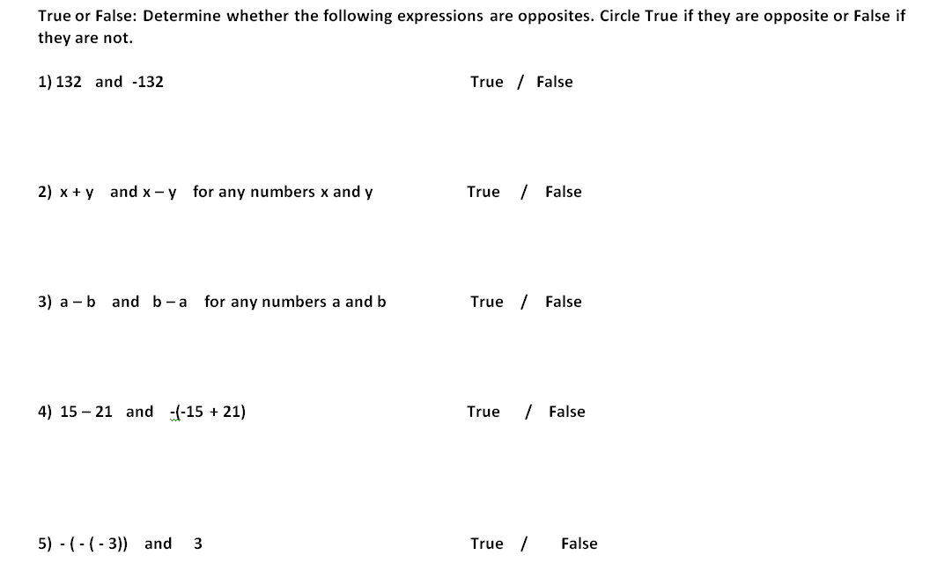
Assessment – Exit Ticket
Agenda
Notes:
(2- min) 51-53
In-Class Notes
This should be an individual exit ticket. Encourage students who have mastered the standard to attempt the bonus question.
Preparation Notes
Print out a copy of the exit ticket for each student to hand out at this time.

Slide 30
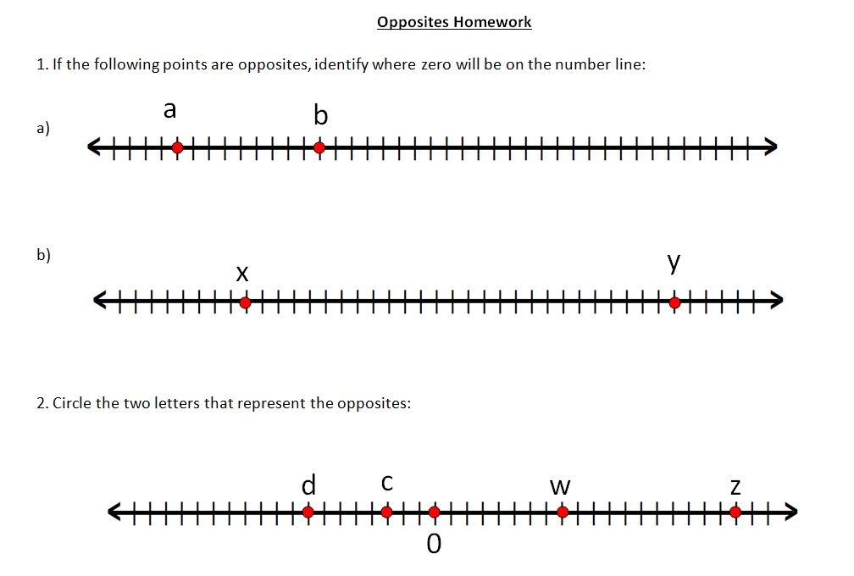
Opposites Homework
Agenda
Notes:
(2- min) 53-55
In-Class Notes
Pass out the homework, and encourage all students to try the bonus questions, especially if they have mastered the material in class.
This homework is designed to make sure the students understand the concept of reflection in regards to an opposite. It shouldn’t take two long, and hopefully it gives them confidence moving forward with negative numbers in the future.
Preparation Notes
Print out a copy of the homework for each student to hand out at this time.

Slide 31
Standards for This Unit
The lesson that you are currently looking at is part of a unit that teaches the following Common Core Standards:
6.NS.6a. Recognize opposite signs of numbers as indicating locations on opposite sides of 0 on the number line; recognize that the opposite of the opposite of a number is the number itself, e.g., –(–3) = 3, and that 0 is its own opposite.
Next Slide
Back to Overview

